Slide 1
Browser-based Web Developer Tools
UNC Webmasters Meeting
March 2, 2011

Slide 2
Overview
An amazing range of possibilities, covering virtually every aspect involved in web page/site development!
Notes:
Next several slides are part of the initial overview, looking at range of developer roles and related tools, as well as emphasize the overlap of these roles/tools. They are mostly for the purpose of the documenting the wide range of tools, for later digestion, and I will be going through these quickly and will not be spending any time on details regarding what thesedo specifically/how they work.

Slide 3
Types of Tools Available
There are several types of browser-based tools, and available to Firefox, Chrome, and MSIE:
Browser toolbars—combine multiple tools into integrated group
Full fledged menu bars are installed on the browser
Web Developer, WAVE, FF Accessibility Extension
Browser extensions/plug-ins—these do one or two functions
Show up as an icon on your browser (icon location depends on browser and/or browser version), or is available from the Menu Bar
Colorzilla, Fireshot, WAVE
Local applications/applets that interact with your browser
Must be downloaded and installed on your local computer
HTML Validator, Foxit PDF Reader
Links to external Web resources
Create a Bookmarks Toolbar folder to hold these
WAVE, Filezilla (FTP client), Browsershot (browsershots.org/)
Built in
In MSIE 9 the F12 key opens a Firebug like window
Notes:
Not all tools are browser extensions or plug-ins, though all are browser-based. A little caution: some do require installing an applet or client on your local computer.
Some available through browser toolbars, some as icons on your browser, others through right (alternate) click context menus.

Slide 4
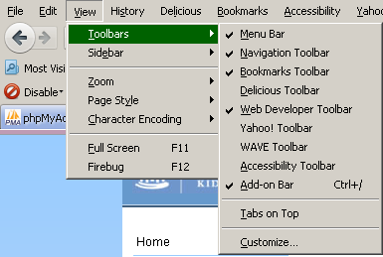
Toolbars
A few full featured extensions show as a possible toolbar selection under View -> Toolbars

Slide 5
A few have their own full tool bar.
Many other extensions show up on the upper right of the browser as icons.
And still others show at the bottom of the browser. This is the Add-on Bar, under menu bar choices.

Slide 6
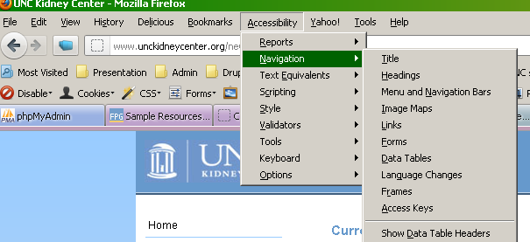
Special addition to toolbar
The UIUC Accessibility extension adds itself to the main Menu Bar and so the features are available directly from here.

Slide 7
Tools for every facet of web development
Web site/page development involves many discreet, though sometimes also overlapping, skillsets:
Page analysis
examine/assess numerous underlying properties of a page
Usability and accessibility implementation and validation
Page layout and design
Image management, CSS and
Programming/coding/scripting
HTML, PHP, ASP, ColdFusion, JavaScript—markup help and debugging
Multimedia - audio/visual components
Content and asset management
Database administration and management?
Analytics and Search Engine Optimization (SEO)
Understand how site visitors actually use/travel your site
Improve your site’s search engine ranking
Much more …
Notes:
And I mean for every face of web development!

Slide 8
Page analysis—looking behind the scenes
Ensuring HTML, CSS, JavaScript, etc., validation
Assessing document structure, performance analysis, broken links, etc.
Tools:
Web Developer (toolbar)
Firebug—unique in that it has 175+ add-ons to enhance it
Yslow (requires Firebug) – page performance
LinkChecker
Total Validator (toolbar, local client applet)
HTML Validator
SeoQuake & Website Analysis
WAVE (external site with local client applet)
Notes:
I will be looking closely at the capacity for page analysis available with the Web Developer toolbar following this overview. WDT is highlighted because it contains tools that belong to many of the following categories.

Slide 9
Addressing Accessibility and Usability
View and evaluate a page from many vantage points by disabling CSS, JS, colors, cookies, images, etc. Identify document structure; navigate through a page via different methods. Is the page accessible?
Tools:
Web Developer (toolbar)
WAVE (wave.webaim.org)
Accessibility Evaluator for Firefox (FAE, html.cita.uiuc.edu)
Currently incompatible with FF 10.x +
Fangs—A screen reader emulator (external link)
Browsershot (external link: http://browsershots.org/)
Notes:
I’ll be filling this in a bit more, especially since it is a high value target.
www.standards-schmandards.com/projects/fangs/

Slide 10
Page Layout and Graphic Design
Developing and analyzing the visual structure of page, image management, working with style sheets (CSS), cross browser review
Tools:
Web Developer (toolbar)
Firebug
Rainbow color tools
ColorZilla
Fireshot
Screengrab (incompatible with FF9.x +)
MeasureIt
FontFinder
Browsershot (external link: http://browsershots.org/)
http://crossbrowsertesting.com/
Notes:
Rachell will help cover this group of tools.

Slide 11
Programming/coding/scripting
Programming checkers/validators and tips. A number of these involve links to external websites
Tools:
Firefox PHP Developer Toolbar
Easy PHP
Asp.Net Menu
Javascript Debugger
Railsbug
MySQL query builders (most of these are desktop applications)
ODBC Bridge for HTML5
Notes:
Look this over for other key tools and/or websites? Anyone?

Slide 12
Multimedia - audio/visual components
Any extensions for this?
Notes:
I don’t do much with this stuff and so am unfamiliar with browser tools. I have and have used some local applications such as cinemaforge and some audible.

Slide 13
Other Developer Related Extensions
Many of these are more for web site administrators but may also be use for site developers. Just a few to give you the kind range these encompass.
Tools:
OpenWith
launches the html/php/js-files you are working on in your web application from a list
PDFescape—PDF editor (free)
WHOIS Lookup
DNSQueries.com Toolbar
QR Code Creators/Readers
Websecurify
Notes:
Still being filled in.

Slide 14
Web Developer Toolbar
A brief look at the many features available with this single toolbar plug-in:
Notes:
This was a live walk through of the many, many features and capabilities of this single toolbar. It covers a huge range of helpful tools.

Slide 15
Resources and links
https://addons.mozilla.org/en-US/firefox/
http://www.standards-schmandards.com/projects/fangs/
http://oit.ncsu.edu/itaccess/web-accessibility-testing-resources
http://browsershots.org/

