Slide 1
DIGITAL SERVICES UPDATE
April 2, 2015
WEBMASTERS
Presented by the Digital Services team

Slide 2
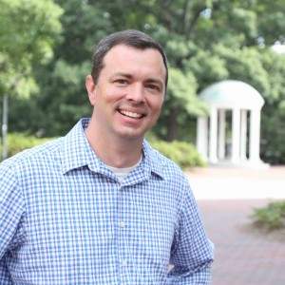
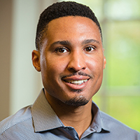
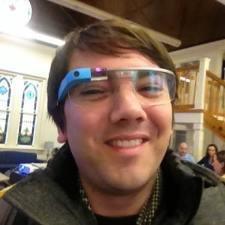
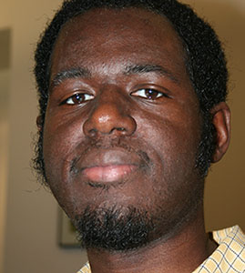
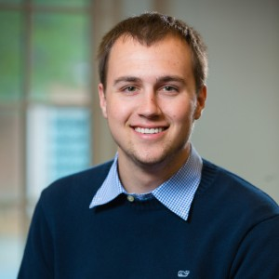
Digital services
The name change
Our work
Support WebDotUNC
Provide standard development consulting
Provide custom development services
What we don’t do…yet.
The team

Slide 3
Digital services | SUpport
Forums
Email webdotunc@groups.unc.edu
Submit a Remedy ticket
Call the HelpDesk
These are all legitimate
ways to get support, BUT…
Contact your favorite developer

Slide 4
Digital services | support
If you have a WebDotUNC site:
If you have a sites.unc.edu site:
Question not about site-specific customizations
Question concerning site-specific customizations:
Forums
Email webdotunc@groups.unc.edu
Call the HelpDesk

Slide 5
Digital services | Support + Training
In-person
One-on-one training
New ideas:
Training sessions and workshops by topic
Ex. Introduction to Heelium
Ex. WebDotUNC plugin overview
Office hours
Half-day user summit
Lynda.com

Slide 6
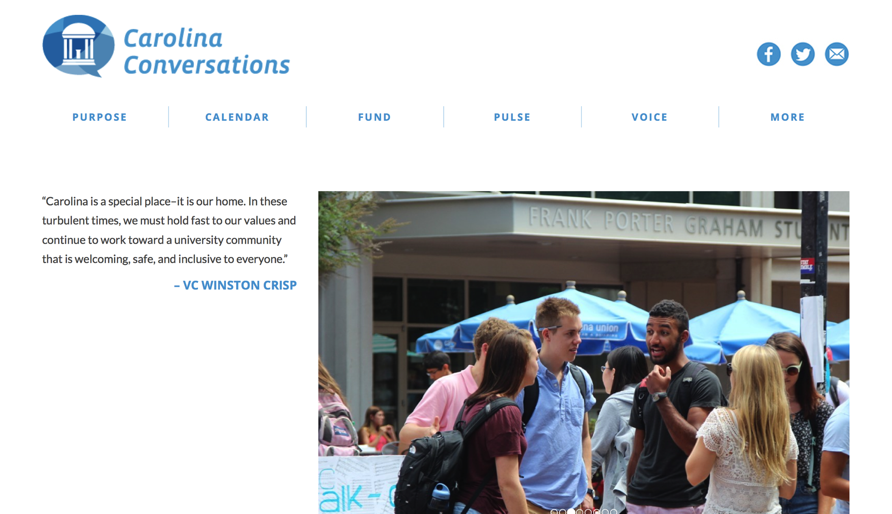
Wordpress showcase
We need new showcase sites!
Show off your work
Share with the community
Provide advice for others

Slide 7
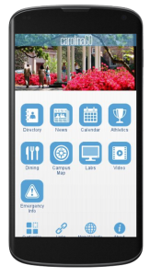
Carolinago | university’s app
The University’s official mobile app
Started by a group of student developers
Features include:
Directory
News
Events
Maps
Bus tracker
Social media
Coming soon: ConnectCarolina for students
How YOU can help

Slide 8
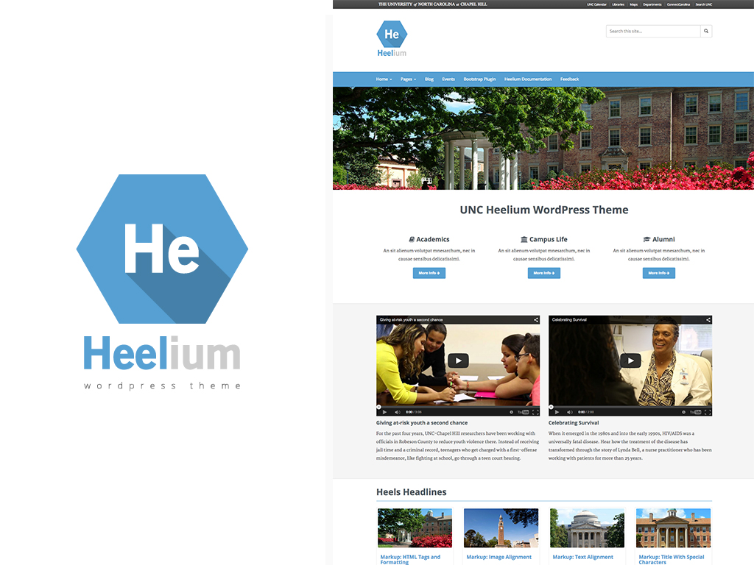

Slide 9
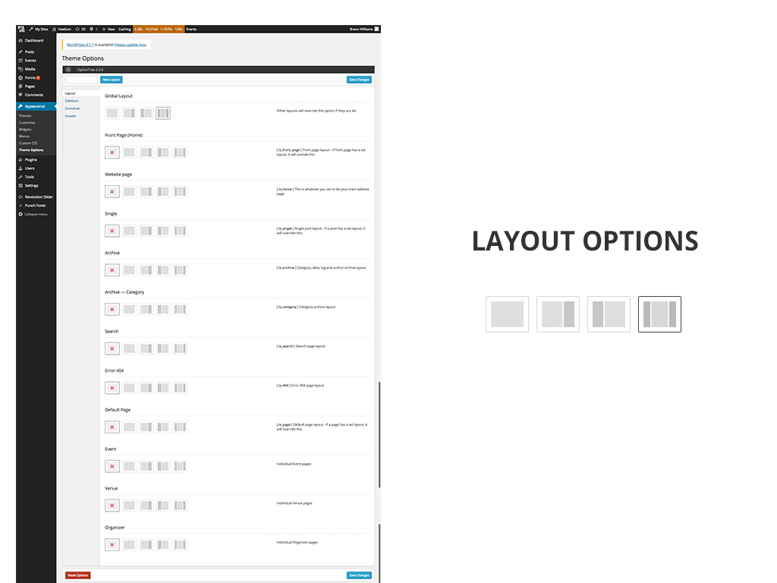

Slide 10
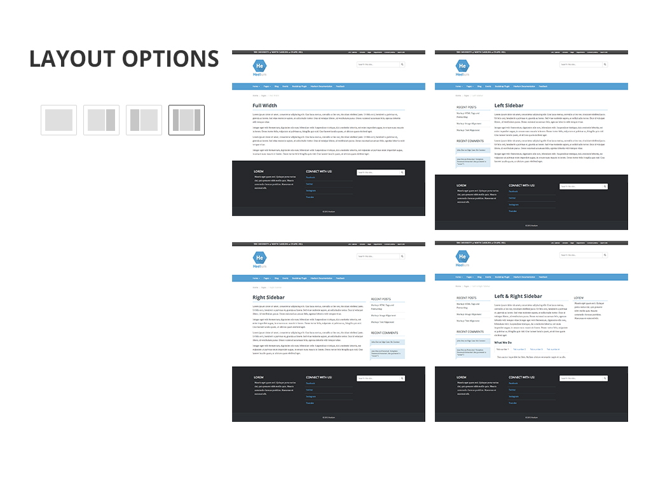

Slide 11
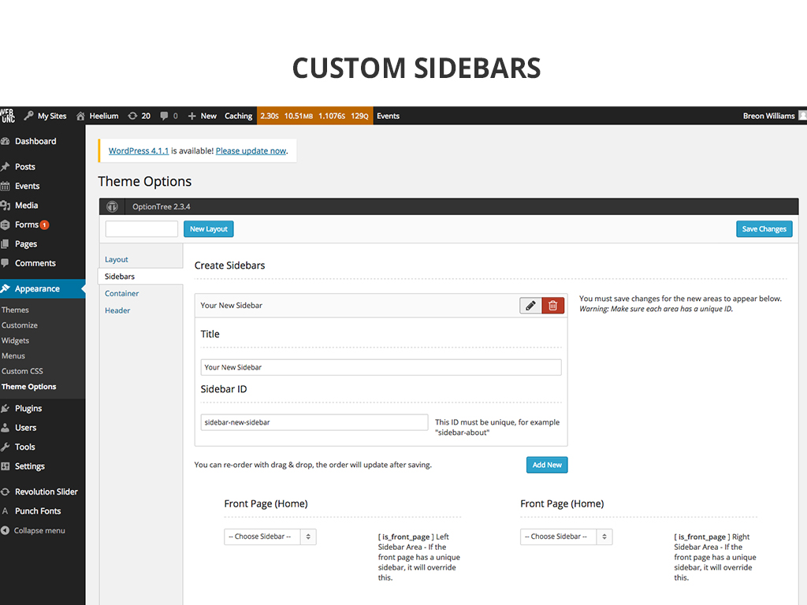

Slide 12
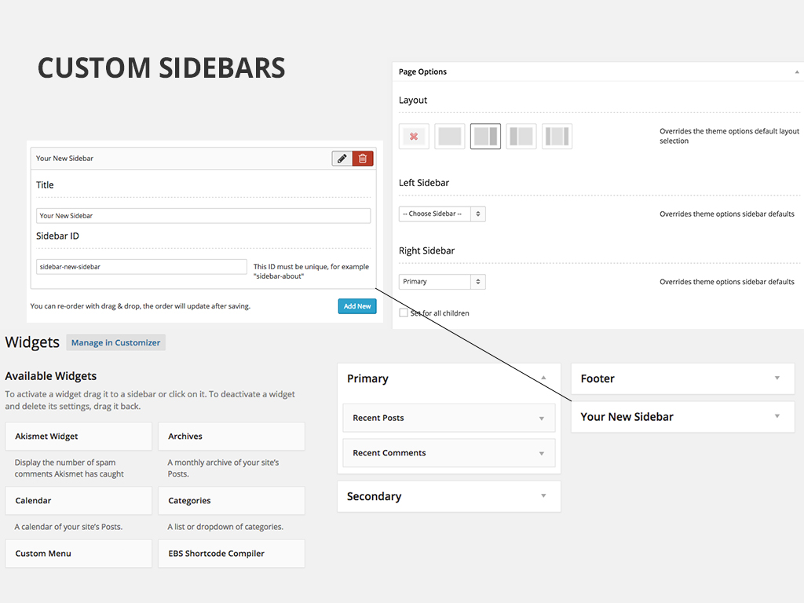

Slide 13
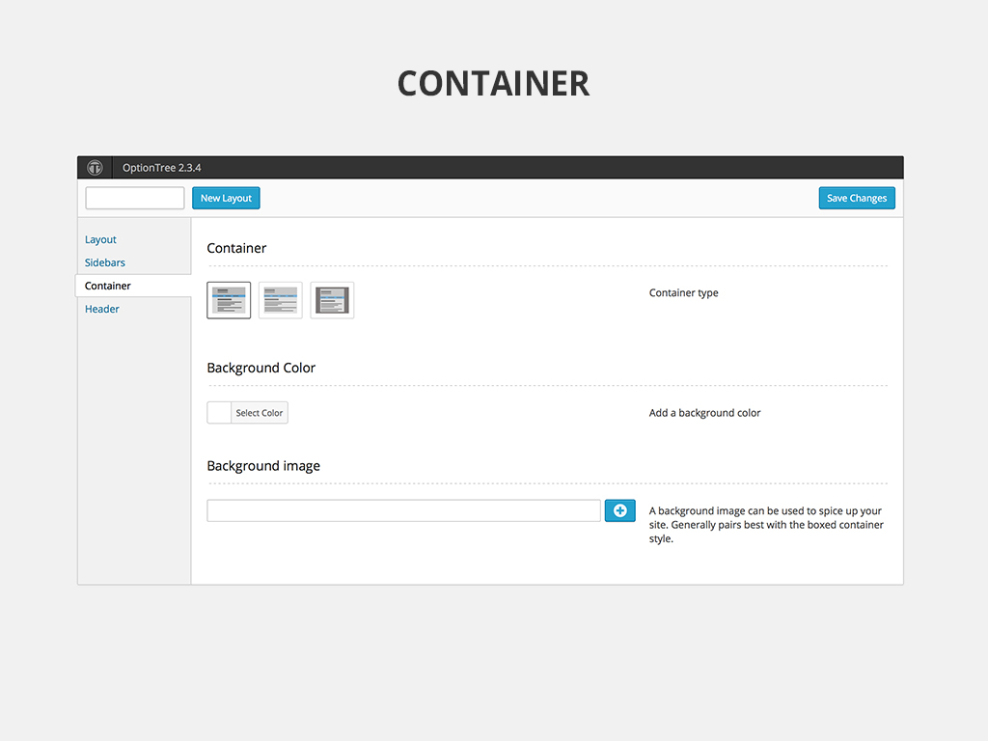

Slide 14
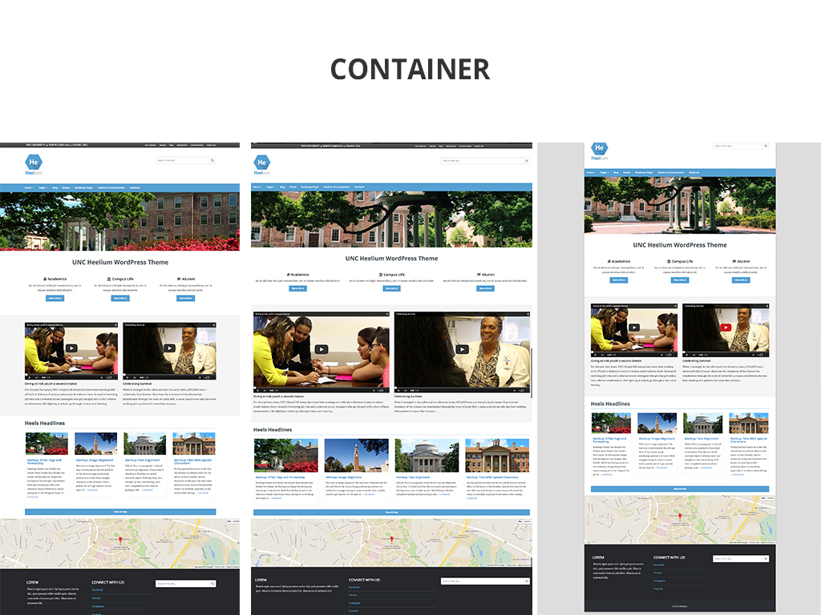

Slide 15
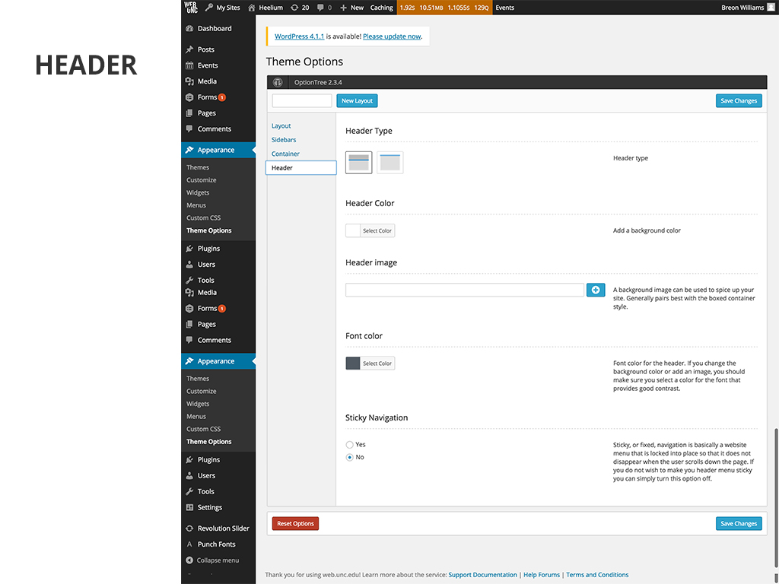

Slide 16
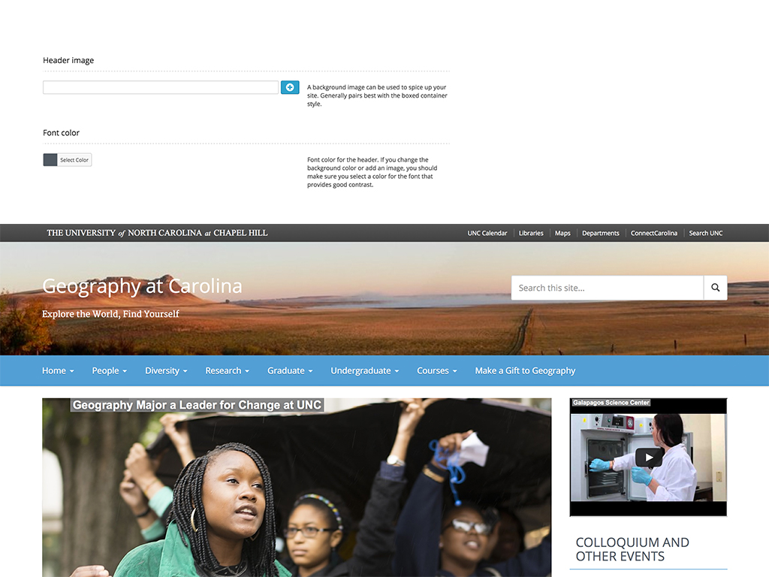

Slide 17
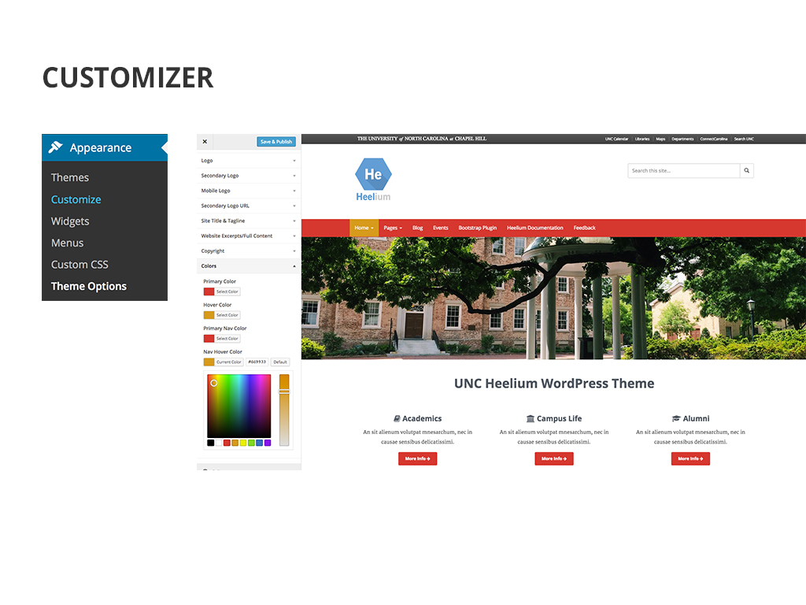

Slide 18
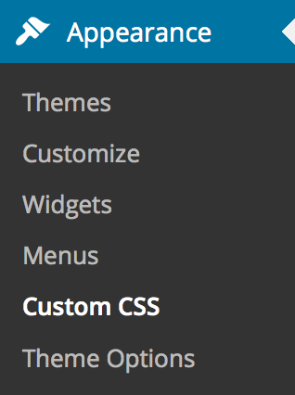
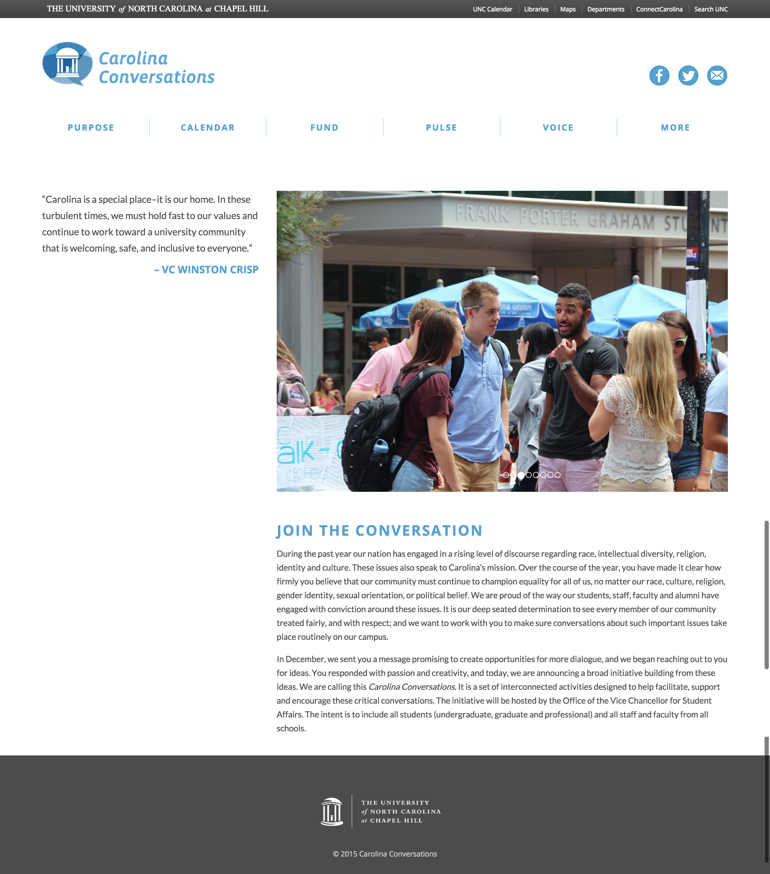
CUSTOM CSS

Slide 19
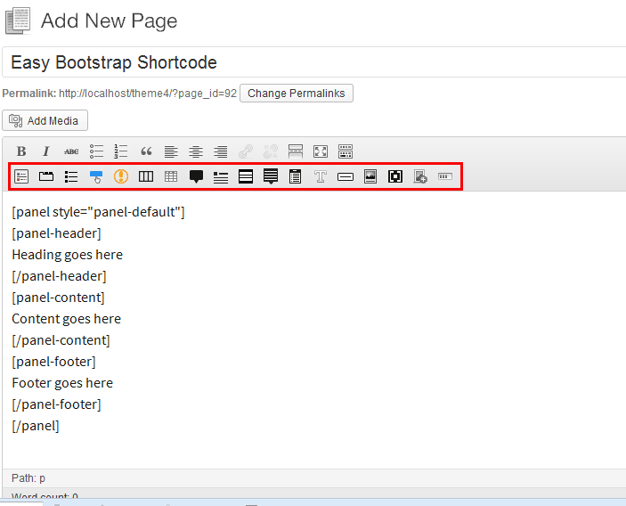
EASY BOOTSTRAP SHORTCODE

Slide 20
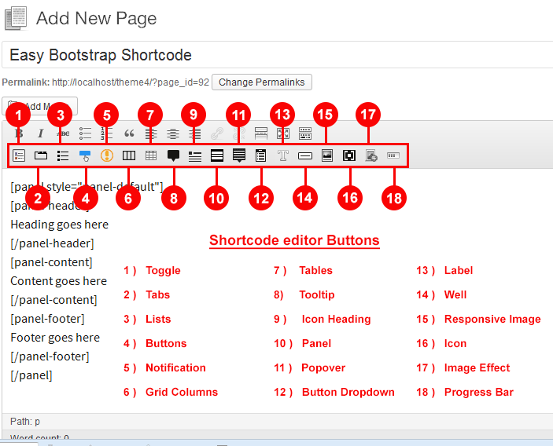
EASY BOOTSTRAP SHORTCODE

